Slide 1
Provider Burnout You can’t pour from an empty cup
By Dr. Brian Isaacson, MD, MBA
Associate Chairman Department of Psychiatry
Psychiatry Residency Training Director
Associate Medical Director of Undergraduate Medical Education
and Dr. Melanie Beck, DO PGY-II

Slide 2
Notes:
This quote is from Albert Schweitzer who was a physician, theologist, philosopher, and musician who received the Nobel Peace Prize in 1952 for his philosophy of Reverence of Life
-I included this quote to point out that burnout can affect anyone and it is not a permanent state
I’d like to also mention some relevant statistics
Over 50% of physicians reported at least one symptom of burnout.
About 1 physician in the US dies by suicide per day (about 400 per year)
Affects more than just physicians and medical students it affects all providers, anyone taking care of someone else really
As we move forward keep in mind that one of the most common reasons people list for not seeking treatment or asking for help was fear of adverse professional consequences

Slide 3
Objectives
Determine three key components of Burnout
Discuss the cyclical and resources model of Burnout
Examine work and life events leading to Burnout
Look at how Burnout has evolved since the development of COVID-19
Recognize the 5 stages of Burnout
Offer strategies for providers with Burnout to reset

Slide 4
What is Burnout?
Notes:
So what is burnout?
If I were giving this lecture live I would ask everyone to pause for a second and think about what burnout looks like but for the sake of the recording let’s continue

Slide 5
Notes:
This might be a common image that comes to mind when I say the term burnout
Let’s break down the three key components of burnout in the next few slides

Slide 6
Three Components of Burnout
Three components of burnout
1.) Emotional exhaustion*
Feel fatigued, lack of energy to accomplish a task
2.) Depersonalization
Cynically treat others as objects
3.) Diminished competency
Decreased sense of self-efficacy
Notes:
Sultana
Emotional exhaustion-feeling frustrated, constantly trying to solve problems but efforts might be futile, maybe having communication issues with staff
Ex:This might be the provider who comes home and collapses on the couch, maybe they aren’t really able to interact with their family or enjoy their life
Depersonalization-not treating others in a humanistic way, cynically treating others meaning showing contempt for accepted standards, maybe trying to exploit others, or even just be pessimistic
Ex: This might be the provider who is having trouble treating their patients as a person, someone might be having an inner monologue of “this is just another patient with a chronic condition like diabetes or substance use, the provider may feel like why even bother counseling if the patient isn’t trying to get better
These providers really have trouble approaching their patients in a holistic way, they have these automatic negative thoughts and might not approach it from the angle of why is this patient non-compliant
Diminished competency-trouble doing things successfully or efficiently
Ex: Providers may feel like they are not good enough or just can’t do the job
-might also ask ”does what I do have any value” and “Do I lack the skills to do this job”
-If something goes wrong at work, it affects all aspects of their life and they are not able to see their other strengths
-It is important to watch out for providers who display an increase in these types of biased comments about patients and the ineffectiveness of treating them as It is a clear symptom of burnout
Moving on I want to focus on what has been shown to be the strongest predictor of burnout

Slide 7
Emotional Exhaustion
Emotional exhaustion has the strongest relationship with quality and safety of health care
Depersonalization (2nd)
Reduced personal accomplishment (3rd)
Emotional exhaustion affects both perceived quality of care and patient satisfaction
Causes safety issues
Ultimately puts patients at a higher risk of adverse events
This can even lead to greater liability for health care associations
Notes:
Salyers
As we mentioned before some providers may either think or feel like they are having trouble with their home life and can’t really reset
-they might simply mention they are exhausted all the time
If providers cannot reset at home it’s really hard to reset before returning back to work
This might show up is not being able to connect with their patients, maybe a tragic event happens and the provider really isn’t able to show empathy or how they are feeling
Also consider mindset of providers:
“I have to see 20 patients. How am I going to get this all done today?” or I can look at the day as “I have the opportunity to improve the lives of 20 patients today.”

Slide 8
Cyclical Model
Cyclical Model: Describes how burnout negatively effects the quality of care
Physician experiencing burn out
Worse health outcomes
Dissatisfied patients
Poor adherence
Notes:
Williams
In moving forward with burnout I want to examine two models, the cyclical model and the resources model of burnout
Physicians experiencing burnout leads to dissatisfied patients (and reduced quality of patient care).
In turn the patient feels frustrated and is less motivated to participate in treatment leading to their poor adherence.
The poor adherence then leads to worse health outcomes which ultimately ends up contributing further to physician burn out.
The cycle continues to perpetuate

Slide 9
Resources Model of burnout
Resources Model: Focuses on the fact that job demands including interacting with patients in an intensive service and balancing personal priorities requires effort over time
This can result in costs to the healthcare provider including emotional exhaustion
Emotional exhaustion can lead to withdrawal of energy from work and ultimately depersonalization
Job demands → emotional exhaustion → depersonalization
Notes:
Boyd, Hakanen, Hobfoll, Van den Broeck
Contrast the cyclical model with the resources model of burnout
The resources model basically describes how balancing job demands and personal priorities requires effort over time
This effort or job demands takes a toll on providers resulting in emotional exhaustion, withdrawal of energy from work and ultimately depersonalization

Slide 10
Burnout in Healthcare Providers
Providers with burnout often experience physical health problems and mental health problems
Physical health problems → insomnia, headache
Mental health problems → anxiety, depression, substance abuse
They may also experience interpersonal relationship problems
Many providers with burnout have report reduced job satisfaction
Associated with excessive employee absences, tardiness, and frequent breaks
Led to providers having reduced commitment to job, poor job performance, and increased turnover at their job
Notes:
Salyers
Providers with burnout are at a higher risk for multiple medical co-morbidities and are less likely to take care of their own physical and mental health needs
As far as mental health goes: anxiety and depression are prominent but substance use has increased even more during the times of COVID due to a few factors:
-easy access to the liquor cabinet at home
-increased stress and fear of the unknown related to COVID
-sort of forced self isolation and limited coping skills
Relationship problems : being forced to spend more time at home with loved ones, the dynamic of relationships is really being altered here
-People are not used to be spending all this time with their significant others
-On another note it has also affected domestic violence and safety of people in potentially dangerous relationships
Trouble at home can lead to trouble in the work environment, we are multidimensional beings and what happens in one situation often translates to another
A study in the Annals of Internal Medicine in 2019 found that burnout related physician turnover costs the nation about 5 billion dollars per year or about 7,600 dollars per physician

Slide 11
How can Burnout be recognized?

Slide 12
Notes:
Figuring out those among us who are at risk of burnout or who have started to already develop burnout

Slide 13
Recognizing burnout
Encourage awareness
Front line leaders need to make people aware of potential problems
Be on the lookout for colleagues experiencing burn out
It can present in multiple ways
Manage expectations
Clarify things such as work hours and responsibilities
Set reasonable goals
Develop resilience
Capacity to recover quickly and spring back into shape
Notes:
Sultana, dewey
Awareness is one of the most important factors. It can occur at multiple levels
-Physician burnout comes with a sense od despair, hopelessness, and isolation. Other symptoms include lack of eye contact and lack of engagement
-Patients might say “that doctor has no personality” or “that doctor didn’t answer my questions”
Developing resilience is one of the most helpful things we can do about this. We will talk more about it later but first let’s talk about different stages of burnout that might help us stay aware.
Recognizing burnout in healthcare professionals can be challenging because most providers tend to suffer in silence. We really have to look deep to recognize burnout

Slide 14
Stage 1
Stage 1=Honeymoon
High job satisfaction, commitment, energy, and creativity
Patterns of coping strategies that develop here can be an issue
If the coping patterns are positive and adaptive then hypothetically someone can remain in the honeymoon stage indefinitely
Very rare
Notes:
Stages of Burnout. Stress Management Website. Retrieved October 12, 2020 from https://www.winona.edu/stress/bntstages.htm.
Honeymoon phase=pretty excited
Coping strategies are usually developed here and become very important

Slide 15
Stage 2
Stage 2=Balancing Act
Clearly aware that some days are better then others when it comes to handling stress
Increase of the following:
Job Dissatisfaction
Work Inefficiency
Fatigue
Sleep Disturbances
Escapist Activities of Choice
Notes:
Stage 2=the balancing act, learning how to manage your stress
Work inefficiency can be avoiding making necessary decisions, losing things at work even on your desk
Fatigue can be general fatigue accompanied by deep muscle fatigue
Sleep disturbances-you are so busy in your head that you can’t get to sleep
Escapist activities of choice-include eating, drinking, smoking, zoning out in front of the TV

Slide 16
Stage 3
Stage 3=Chronic symptoms
Intensification of stage 2
Includes:
Chronic Exhaustion
Physical illness
Anger
Depression
Notes:
Stage 3=chronic symptoms, really just worsening of symptoms
Remember that stress is a risk factor in many disease as we mentioned before insomnia, headache, anxiety, depression, substance use to name a few
This might be easier to recognize in some of our colleagues but difficult to recognize in ourselves

Slide 17
Stage 4
Stage 4-Crisis
The symptoms become critical
Physical symptoms intensify or increase in number
Obsess about work frustrations
Pessimism and self-doubt dominate
“Escapist mentality”
Notes:
Stage 4=crisis, things really get critical here
Escapist mentality=ignore the features of reality that cause stress and use other alternatives to cope, trying to escape the current situation (substances or other strategies that might be considered unhealthy)

Slide 18
Stage 5
Stage 5-Enmeshment
Symptoms of burnout are so embedded in life
More likely to be labeled as having some physical
or emotional problem than to be labeled as
having burnout
Notes:
Stage 5=the final stage, enmeshment
Difficult to recognize that this is even burnout at this stage
This is often mistaken for other things
It becomes an issue when the underlying factors are not addressed and can become almost a cycle that providers can get caught in

Slide 19
What can we do if we recognize burnout?
“Throw them a lifeline when they might be drowning”
Approach with kindness and respect, you might have been in their shoes or be in the future
Be empathetic and compassionate
Reassure your colleagues that seeking help is a sign of strength and not weakness
Encourage them to speak to family, other phroviders, or seek out professional help
Notes:
At some point in our career we are likely to see a colleague who is suffering from symptoms of burnout so what should we do when we recognize this

Slide 20
How has Burnout changed with COVID-19 ?

Slide 21
Notes:
https://www.cdc.gov/breastfeeding/breastfeeding-special-circumstances/maternal-or-infant-illnesses/covid-19-and-breastfeeding.html
We can’t even begin to touch upon how much has changed due to the COVID-19 virus
There aren’t really words or certainly a limited presentation to discuss what has changed
But for the purpose of this lecture we will focus on a few key things:

Slide 22
The onset of COVID
The World Health Organization declared COVID-19 a pandemic on February 11, 2020
Financial instability started to set in
Unprecedented societal stress and anxiety
Impending overall economic downturn
Uncertainty about future occupational issues
Notes:
Joshi, Sansogar
With financial limitations how do you really plan for the future, this is alco challenging when when the future is so uncertain and it seems like it might be hard to define

Slide 23
The Work Environment
The work environment has changed
Longer work hours, limited resources available at work
Disrupted work-life balance → sleep disturbances and fatigue
Risk of getting infection
Taking care of patients while remembering to take care of yourself
Potentially passing along to loved ones
Anxiety about the asymptomatic carrier phase
Limited autonomy
Going to work and making life choices when the options have been limited
Notes:
Mozzami, Sasangohar, Sultana
Speaking more about limited autonomy
One of the things that can be more beneficial is implementing shared decision making or increasing the amount of perceived shared decision making which can be challenging during the times of COVID

Slide 24
Evolution of Telemedicine
Telehealth has increased in most settings
It can be beneficial for health care workers who are quarantined
Misconception that is can replace in-person care
It does not help with patient-provider interaction
Barriers to technology
Reduced development of rapport
Decreased physician satisfaction
May provide a false sense of reassurance to patients
Physical exams cannot be performed
Reduced access to laboratory tests and information
Notes:
Mozzami and Argulian
-Telemedicine really becomes a kind of double edge sword, it can be really great for some providers and for some specialties but for others there can be a strong sense of disconnect
Barriers to technology-connectivity issues, access to high quality internet (difficult if the connection freezes), patient not being familiar with technology, potential HIPPA issues and privacy
-also physical exam limitations, limited access to vitals, objective portion of the exam is really pretty limited
-Even things like access to flu shots or necessary vaccines can’t be provided which leads to a shift in care

Slide 25
Personal Issues
Worrying about the risk of infection and asymptomatic carrier state
What happens if you do get sick?
Risk of putting loved ones at risk
Disrupted social support
Being rejected both by patients and the general public due to being considered “high-risk”
Emotional breakdowns result from choosing between family responsibilities and inner professional duties to others
Notes:
Sasangohar, Sultana
Let’s dive a little deeper into the anxiety that surrounds potentially getting sick ourselves
Who takes care of you when the provider becomes the patient?
Being considered high-risk, when things do open will there be a stigma against providers who may have been exposed?
Constantly pushed and pulled between this inner dichotomy of choosing between personal and professional responsibilities
Keep this information in mind as we talk about a newer topic on the next slide

Slide 26
The “Second Wave”
The Second Wave refers to what is termed the by-products of the initial wave
It does NOT refer to the second wave of COVID
Rebound in medical needs
Intermediate term COVID infection consequences
Patients often ignore care and can become more decompensated
Providers are dealing with different issues and may not have adequate training
Increased anxiety at multiple levels
Worsened family dynamics resulting in marital conflicts
Domestic violence
These factors lead to health care provider burnout
Providers with burnout become part of the by-products as their mental health needs also need to be addressed
Notes:
Argulian, Joshi
There has been some mention about what has been termed the second wave of the pandemic
The second wave does NOT refer to the second wave of the COVID-19 pandemic but actually the by-products of the initial wave
-When I say by-products I mean it’s more of a rebound effect of sequelae
-Rebound in patients verses rebounds in providers
-Also people are really delaying the need for essential medical care such as flu shots for annual wellness exams
For patients they have limited access to ongoing care and may become more decompensated
For providers there are multiple issues contributing to their work environment but also what happens to their mental health
-As I mentioned previously there are multiple issues with family dynamics and people being at higher risk for domestic violence
-Alert to domestic violence is palm to camera and tuck thumb then trap the thumb

Slide 27
How can providers with Burnout reset?

Slide 28
Notes:
How do we rekindle that flame and keep it ignited?
We want to keep that flame burning and keep the passion in our work while preventing the burnout?

Slide 29
Perceived Support
The most important factor is perceived support!
From Medical leadership
Scheduling accommodations, etc.
Designated staff for wellness
From the Community
From each other!
Notes:
Sasangohar
The support of medical leadership can really go a long way, whether it is accommodation with scheduling difficulties, support about everyday issues, or managing the expectations of experiences.
-Adequate supplies can also go a long way and education about proper precautions and PPE can help as well.
AtlantiCare specifically has really great staff appreciation events whether it be rounding to show team support or preparing meals for staff.
Verbal praise is also really important which we can talk more about in the next slide

Slide 30
Messages of Gratitude
Public acknowledgements
Messages of gratitude go a very long way
Often as events last longer the gratitude is taken for granted
Need clear messages that providers are valued
Send out positive messaging that emphasizes appreciation for dedication and altruism
Understanding that we are managing this time together
Share stories of success
Help manage expectations
Notes:
Messages of gratitude go a very long way
It seems that the messages were very evident in the beginning of the pandemic as opposed to the ongoing nature now
While the world is almost adjusting to a new normal the providers may feel like there is less gratitude or people are getting more comfortable with the circumstances. Life seems to go on for some people and for those on the frontline they are still faced with it every day
Its also important to share stories and learn from each other but often times we focus on negative outcomes and how to improve. We really need to be focusing on positive outcomes and how to replicate them. This can really contribute to perspective.
At AtlantiCare various members of the community actually stood outside of the hospital with supportive signs and clapped as the providers left the hospital. It felt really good to have that symbol of gratitude and really feel the support from the community.

Slide 31
Improvements in the work environment
Adequate sleep
Access to call rooms-safe spaces
Decrease workload, improve scheduling
Provide water, healthy snacks, and items such as phone chargers
Involvement in shared-decision making
Opportunities for counseling like Employee Assistance Program (EAP) or the Suicide hotline
Schwartz rounds
Designate employees specifically in charge of wellness
Field concerns that arise
Educate providers and provide solutions to problems
Advocate for providers and encourage self-care
Notes:
Dewey
This slide is really talking about what can we do as well as what can other people who work with us can do to support us
Involvement in shared decision making-being involved and getting feedback or even just being included in the process of decision making can help more especially in a hospital system
Employee Assistance Program or EAP offers help. There is also the suicide hotline which is available for anyone who is experiencing suicidal ideations
Schwartz rounds:
Schwartz rounds are here at AtlantiCare and they are an evidence based tool that has been shown to improve emotional wellness in providers.
Schwartz rounds are a conference that focuses on openly and honestly discussing the social and emotional issues providers face when caring for patients and families.
-The focus is on the human dimension of medicine.
-1 provider who attended stated, “Schwartz Rounds are a place where people who don’t usually talk about the heart of the work are willing to share their vulnerability, to question themselves. “

Slide 32
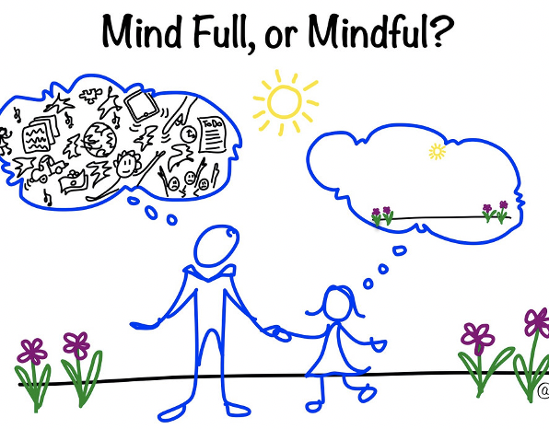
Self-Monitoring
Providers need to be monitoring themselves for burnout and engaging with other providers to determine those who may be at risk
Be aware of amounts of fatigue, stress, and sleep
Use digital communication such as mobile health tools
Breathing exercises
Mindfulness to control stress and anxiety
Tele-health for peer support
Understanding the sense of community
Remembering we are all in this together
Groups on coping skills
De-stigmatization
Notes:
Sosangohar
Little things like using technology on your phone or your watch to monitor if you are getting adequate, restful sleep
Use mindfulness or meditation on a daily basis to stay grounded can really make a difference as well
Seeking support from peers to understand common experiences can be helpful especially through tele-health options during this time
Burnout should almost become a vital sign and all providers should be routinely screening themselves while trying to identify those in need of assistance as well
De-stigmatization-helping providers understand that burnout is not a weakness and should also become reviewed daily just like a vital sign
Providers should really be encouraged to not under report their symptoms and shouldn’t feel afraid to speak out
We have to support each other and sometimes recognize potential issues with burnout from a distance
Let’s move on and focus on some of the things that hospitals have done to try to mitigate burnout

Slide 33
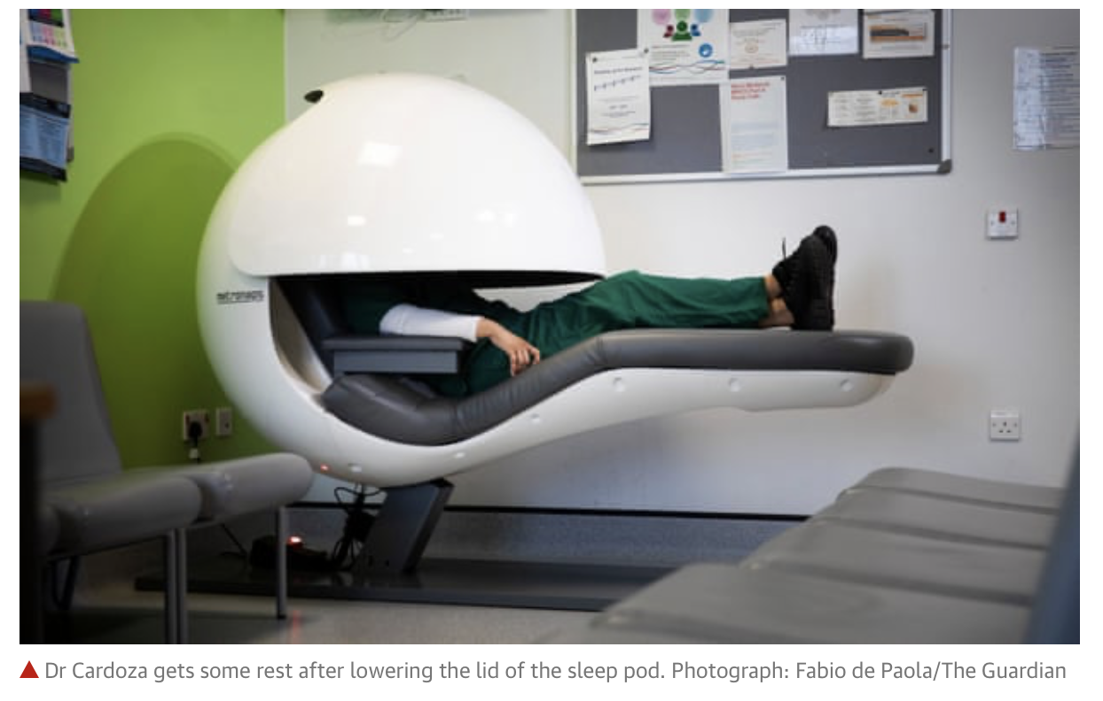
”Sleep Pods”
A hospital in Hereford Country in the UK installed ”sleep pods” for a 3 month period in their hospital
Zero gravity position
Noise cancelling headphones
Screen with gentle music
Purpose is to promote power naps
Periods of rest for 20 minutes
Notes:
A hospital in Hereford County in the UK installed “sleep pods” for a 3 month trial period in their hospital.
The pod puts you “in a zero gravity position as you sit in the pod. You then put on noise cancelling headphones on, a screen comes in front of you which you manually pull around and it plays some gentle music that is supposed to be calming and promote a power nap. The hospital states they hope their physicians will use it to take 20 minute power naps or rest breaks.
https://www.theguardian.com/society/2020/feb/03/nhs-hospitals-bring-in-sleep-pods-to-help-tired-staff-take-a-break-picture

Slide 34
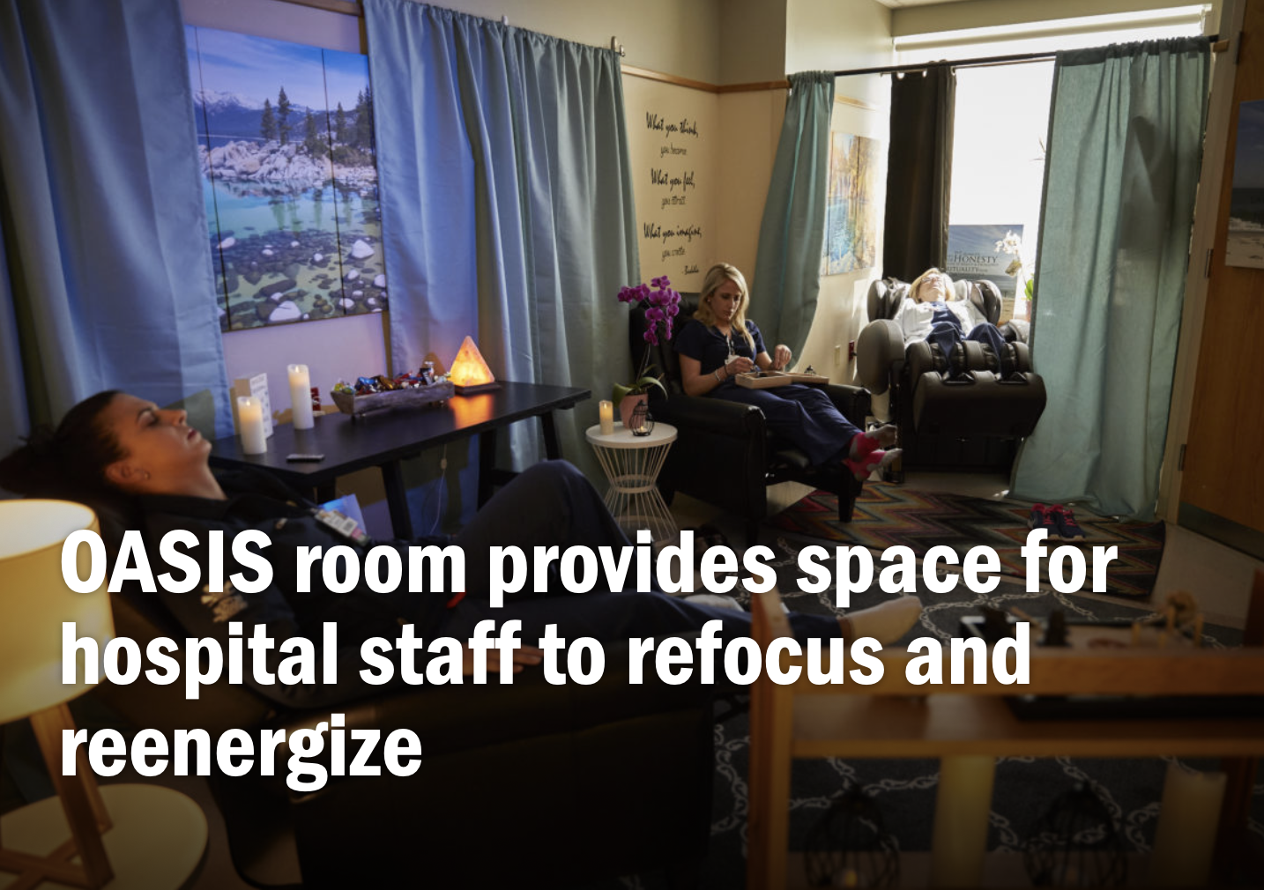
OASIS room
Christiana Hospital in Delaware developed the OASIS room
Opportunity to Achieve Staff Inspiration and Strength
Quiet space
Regroup
Reflect
Refresh
https://news.christianacare.org/2017/05/oasis-room-provides-space-for-hospital-staff-to-refocus-and-reenergize/
Notes:
OASIS room for staff to refocus and re-energize at Christiana Hospital-quiet space to regroup, refresh, and reflect
Opportunity to Achieve Staff Inspiration and Strength
https://news.christianacare.org/2017/05/oasis-room-provides-space-for-hospital-staff-to-refocus-and-reenergize/
AtlantiCare room with massage chair, treadmills, and workout space

Slide 35
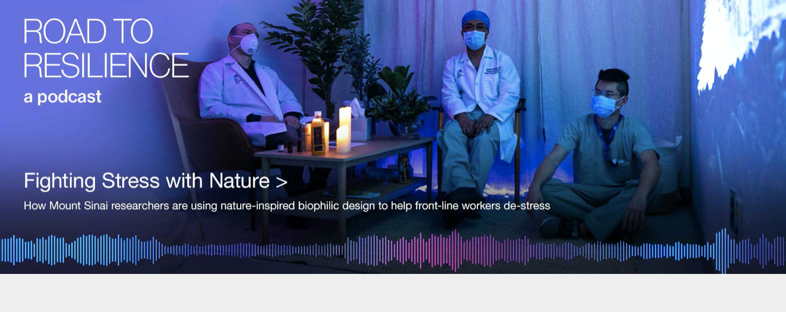
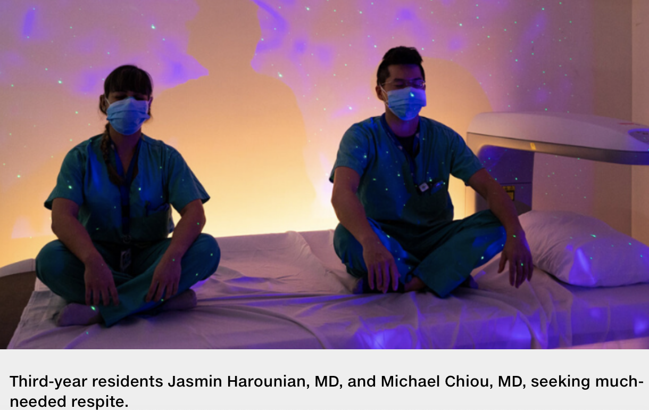
Recharge Room
Mt Sinai hospital in New York
In collaboration with Studio Elsewhere, Abilities Research Center and David Putrino PhD
Focused on connection between natural environments and stress reductions
Multi-sensory experiences
Visual, Auditory, Olfactory
Reduce stress in 15 minutes
Decrease BP, HR, Stress hormones
Notes:
Recharge room at Mt Sinai
https://www.mountsinai.org/about/newsroom/road-resilience/recharge-room
David Putrino PhD converted his lab into a recharge room for front-line healthcare workers. Focused on connection between natural environments and stress reduction they create multi-sensory experiences that can reduce stress in 15 minutes.
The recharge rooms were conceived by Studio Elsewhere and the Abilities Research Center, part of the Department of Rehabilitation and Human Performance at the Icahn School of Medicine at Mount Sinai, in support from The Office of Well-Being and Resilience at Mount Sinai.
The immersive audio content in the recharge rooms was created by EMBC studio composer Jacob Marshall and violinist Tim Fain
Focuses on how natural environments can relieve stress and how even short exposures to natural environments can create stress relieving effects.
Artificial plants and sit in an experience surrounded by these plants to make you feel like you’re in a forest, also images if campfires, and waterfalls. Stimulated visually and then also auditory stimulation including composers to create music experiences using specific tempos, timbre of music, and intervals of music that reduce stress. It also utilizes the sense of smell and aromatherapy to replicate these environments. Then project HD images of different nature scenes. Bring in all sorts of experiences that have been shown over years of research to reduce blood pressure, decrease heart rate, reduce stress hormones in the observer.

Slide 36
Being mindful of wellness
Increase awareness of necessity for personal time
Wellness is different for everyone
Utilize sick/personal and vacation days
Take time to reset away from daily stressors
Turn off electronic devices and limit access to emails
Find what works for you
Make sure to implement rituals into your daily routine
Make time even when there isn’t time
Notes:
Wellness is different for everyone but there should be attention paid to encouraging wellness and setting aside adequate time to reset each week
Often vacation can accumulate but it is often necessary to take sick or personal days throughout the year, try to eliminate some barriers to taking vacation such as coverage
Time is really the most important variable and unfortunately time is a huge limiting factor with all of the providers during this time. Taking some time even when it feels like there isn’t time, even if it is just 5 minutes a day when you wake up or go to bed or even use the bathroom can really make a huge difference in preventing burnout.
Make time even when there isn’t time, this is arguably the most important time you can take each day to prevent losing time in the future
In 2016 US Surgeon General Vivek Murthy said “If healthcare providers aren’t well, it’s hard for them to heal the people for whom they are caring”

Slide 37
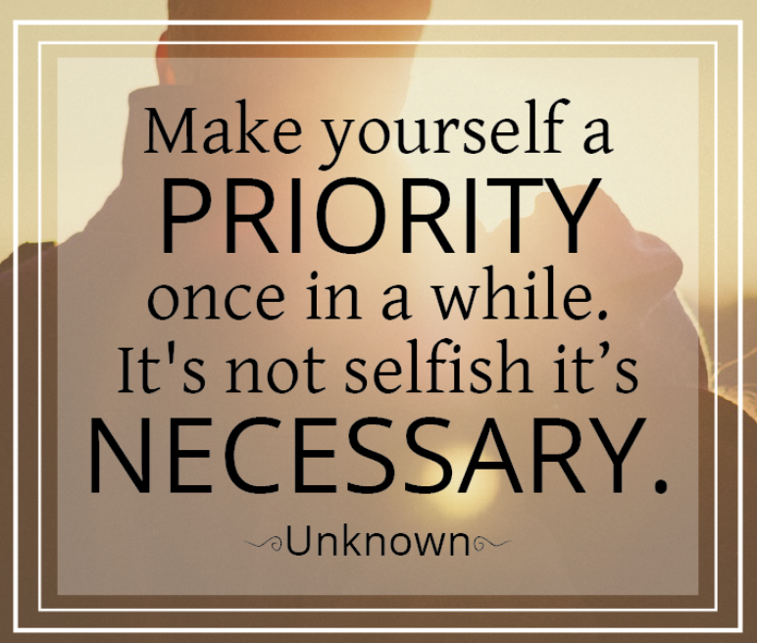
Notes:
I will leave you with another quote.

Slide 38
References
Argulian, E. (2020). Anticipating the “Second Wave” of Health Care Strain in the COVID-19 Pandemic.
Boyd CM, Bakker AB, Pignata S, Winefield AH, Gillespie N, Stough C. A longitudinal test of the job demands‐resources model among Australian university academics. Appl Psychol Int Rev. 2011;60:112–40. doi:10.1111/j.1464-0597.2010.00429.x
Dewy, C., Hingle, S., Goelz, E., & Linzer, M. (2020). Supporting clinicians during the COVID-19 pandemic.
Hakanen JJ, Schaufeli WB, Ahola K. The Job Demands-Resources model: a three-year cross-lagged study of burnout, depression, commitment, and work engagement. Work and Stress. 2008;22:224–41. doi:10.1080/02678370802379432.
Hobfoll SE. Conservation of resources: a new attempt at conceptualizing stress. Am Psychol. 1989;44:513–24. doi:10.1037/0003-066X.44.3.513
Joshi, G., & Sharma, G. (2020). Burnout: A risk factor amongst mental health professionals during COVID-19. Asian journal of psychiatry, 54, 102300.
Moazzami, B., Razavi-Khorasani, N., Moghadam, A. D., Farokhi, E., & Rezaei, N. (2020). COVID-19 and telemedicine: Immediate action required for maintaining healthcare providers well-being. Journal of Clinical Virology, 104345.
Salyers, M. P., Bonfils, K. A., Luther, L., Firmin, R. L., White, D. A., Adams, E. L., & Rollins, A. L. (2017). The relationship between professional burnout and quality and safety in healthcare: a meta-analysis. Journal of general internal medicine, 32(4), 475-482.
Sasangohar, F., Jones, S. L., Masud, F. N., Vahidy, F. S., & Kash, B. A. (2020). Provider burnout and fatigue during the COVID-19 pandemic: lessons learned from a high-volume intensive care unit. Anesthesia and analgesia.
Shanafelt TD, Hasan O, Dyrbye LN, Sinsky C, Satele D, Sloan J, et al.Changes in burnout and satisfaction with work-life balance in physicians and the general US working population between 2011 and 2014. Mayo Clin Proc. 2015;90:1600–13. doi:10.1016/j.mayocp.2015.08.023.
Sultana, A., Sharma, R., Hossain, M. M., Bhattacharya, S., & Purohit, N. (2020). Burnout among healthcare providers during COVID-19 pandemic: Challenges and evidence-based interventions.
Summers, R. F., Gorrindo, T., Hwang, S., Aggarwal, R., & Guille, C. (2020). Well-being, burnout, and depression among North American psychiatrists: the state of our profession. American Journal of Psychiatry, appi-ajp.
Stages of Burnout. Stress Management Website. Retrieved October 12, 2020 from https://www.winona.edu/stress/bntstages.htm.
Tandon, R., 2020. The COVID-19 pandemic, personal reflections on editorial responsi- bility. Asian J. Psychiatr. 50, 102100. https://doi.org/10.1016/j.ajp.2020.102100.
Van den Broeck A, Vansteenkiste M, De Witte H, Lens W. Explaining the relationships between job characteristics, burnout, and engagement: the role of basic psychological need satisfaction. Work and Stress. 2008;22:277–94. doi:10.1080/02678370802393672
Williams ES, Savage GT, Linzer M. A proposed physician-patient cycle model. Stress Health. 2006;22:131–7. doi:10.1002/smi.1088.
Notes:
Additional sources cited under their respective slides as below:
https://www.theguardian.com/society/2020/feb/03/nhs-hospitals-bring-in-sleep-pods-to-help-tired-staff-take-a-break-picture
https://news.christianacare.org/2017/05/oasis-room-provides-space-for-hospital-staff-to-refocus-and-reenergize/
https://www.mountsinai.org/about/newsroom/road-resilience/recharge-room

